Slide 1
Neurodiversity and self-harm for professionals

Slide 2

Zoom Housekeeping
Please keep cameras on during the session if possible
Please use the ‘hands-up’ icon if you would like to speak or use the chat box to contribute in a way you feel comfortable with.
If you need to go off camera to have a break at any time, please do so.
Sessions are not recorded

Slide 3
Session Outline
Part 1:
The context of young people’s mental health
What neurodiversity is
To understand how neurodiversity can impact mental health
Part 2:
What self-harm is
What causes self-harm
Self care strategies for neurodiverse young people
Further resources/support services
Question and answers (20 mins)

Slide 4
The context of young people’s mental health from The Children’s Commissioner's Mental Health Report 2023-2024
In the year 2023-2024 958, 200 young people were referred for support from CAMHS which was an increase of 9,000 from the year 2022-2023.
This is approx. 8% of all children in England.
Neurodevelopmental conditions like autism and ADHD are not mental health conditions, however children’s neurodevelopment is often assessed in CYPMHS, and neurodevelopmental and mental health conditions do frequently co-occur.

Slide 5
The context of young people’s mental health
31% had their referrals closed without treatment offered.
36% began treatment
33% were still waiting for treatment after a year.
Out of the young people who were still waiting for support, 64% were for suspected autism.

Slide 6
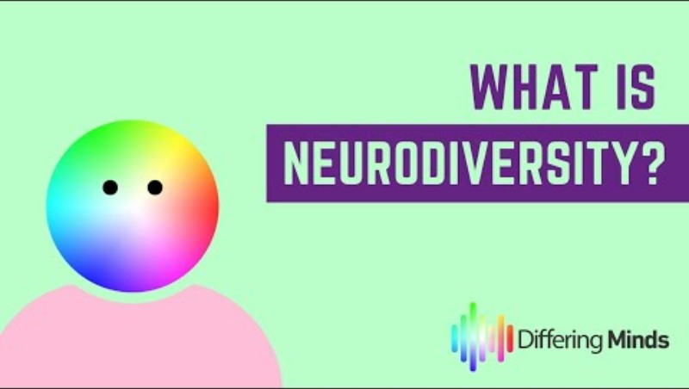
What is neurodiversity?
Source:
What is Neurodiversity?
From Differing Minds on YouTube

Slide 7
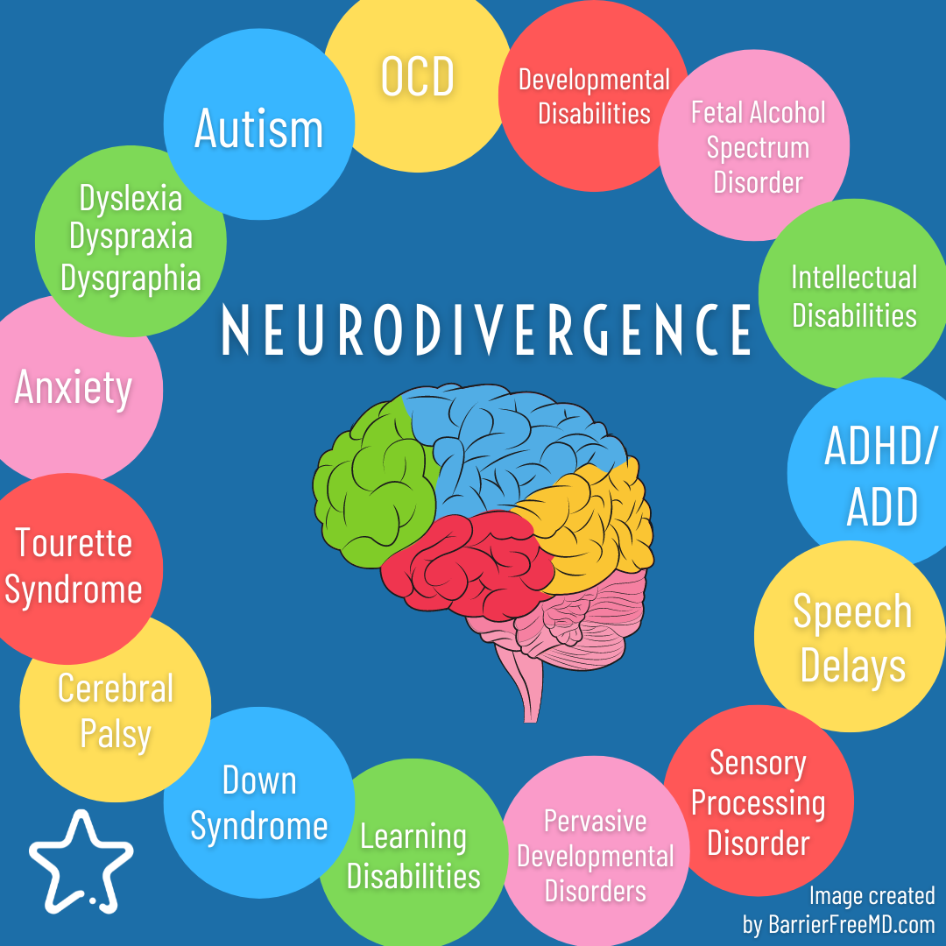
What is neurodivergence?

Slide 8
How does neurodivergence impact mental health?
Chronic Misunderstanding or Misdiagnosis
Neurodivergent people are often misunderstood or misdiagnosed (e.g., autism mistaken for anxiety or vice versa).
This leads to delayed support, internalized confusion, and sometimes inappropriate treatments.
Masking and Camouflaging
Many neurodivergent individuals learn to "mask" their traits to fit in socially or professionally.
This constant self-monitoring is exhausting and can lead to identity loss, anxiety, and depression.

Slide 9
How does neurodivergence impact mental health?
Social Rejection or Isolation
Difficulties with social communication or sensory processing may lead to exclusion or bullying.
Feeling "different" or chronically rejected increases the risk of loneliness and low self-worth.
Sensory Overload
Many neurodivergent people experience hypersensitivity to noise, light, touch, etc.
Chronic overstimulation can trigger anxiety, irritability, and burnout.

Slide 10
How does neurodivergence impact mental health?
Executive Dysfunction
Struggles with planning, focus, memory, and time management can make daily life overwhelming.
This can result in guilt, frustration, and low self-esteem, especially in settings that value productivity.
Systemic Barriers
Education, employment, and healthcare systems are not designed with neurodivergent needs in mind.
Constantly navigating inaccessible environments can create chronic stress and disempowerment.

Slide 11
How does neurodivergence impact mental health?
Internalised Ableism
Repeated exposure to negative stereotypes can lead neurodivergent individuals to believe they are "broken" or "less than."
This internalized stigma often drives depression, shame, and anxiety.
Higher Risk of Trauma
Neurodivergent people are statistically more likely to experience trauma, including bullying, abuse, and institutional neglect.
Trauma exacerbates existing mental health vulnerabilities.

Slide 12

How does trauma impact the brain?
Source: UK Trauma Council on YouTube

Slide 13
How does trauma impact the brain?
Source: UK Trauma Council on YouTube
Reflection Time:
Which parts of the clip resonated or stood out for you?

Slide 14
How does neurodivergence impact mental health?
Lack of Appropriate Support
Support structures often focus on "fixing" behaviour rather than validating neurodivergent experiences.
When support feels judgmental or controlling, it can increase distress rather than reduce it.
Co-occurring Mental Health Conditions
Conditions like anxiety, depression, OCD, and PTSD frequently co-occur with neurodivergence.
These can intensify challenges and compound emotional distress, especially when not properly addressed.

Slide 15
Autism and alexithymia
Alexithymia is the difficulty in identifying, describing, and processing one’s own emotions. It doesn’t mean a person lacks emotions—it means they struggle to recognize and articulate them.
50–60% of autistic individuals experience alexithymia.
When alexithymia and autism co-occur, they can amplify each other’s challenges.
For example:
Social communication difficulties in autism may be worsened by limited emotional awareness.
Emotional regulation becomes harder, potentially increasing anxiety or distress in unpredictable situations

Slide 16
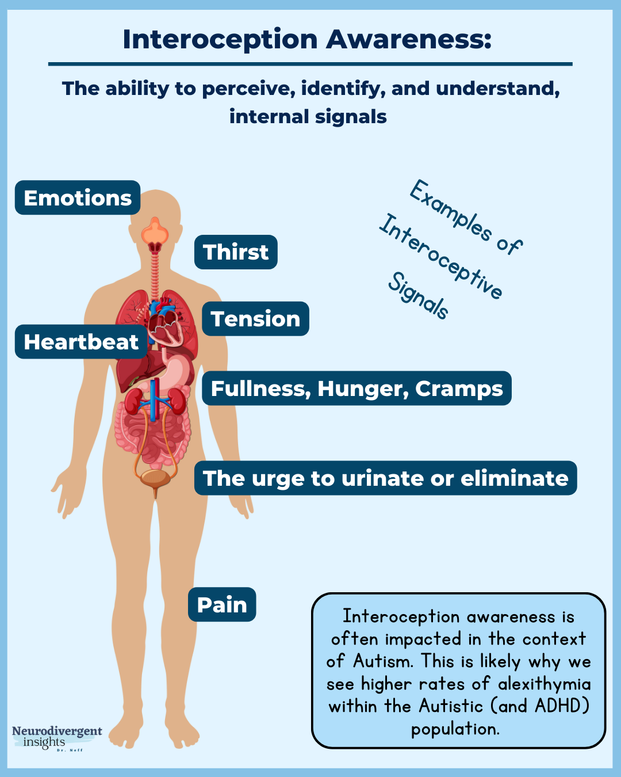
Autism and interoception
Interoception is the sense that helps us perceive internal bodily sensations—like hunger, thirst, heartbeat, or the need to use the bathroom. It also plays a key role in emotional awareness, as emotions often manifest through bodily sensations (e.g., a racing heart when anxious)

Slide 17
How to support autistic young people with alexithymia and interception difficulties
Improving interoceptive awareness can help reduce the impact of alexithymia.
Some approaches include:
Mindfulness and body scanning exercises
Emotion labelling exercises tied to physical sensations
Occupational therapy focused on sensory integration

Slide 18
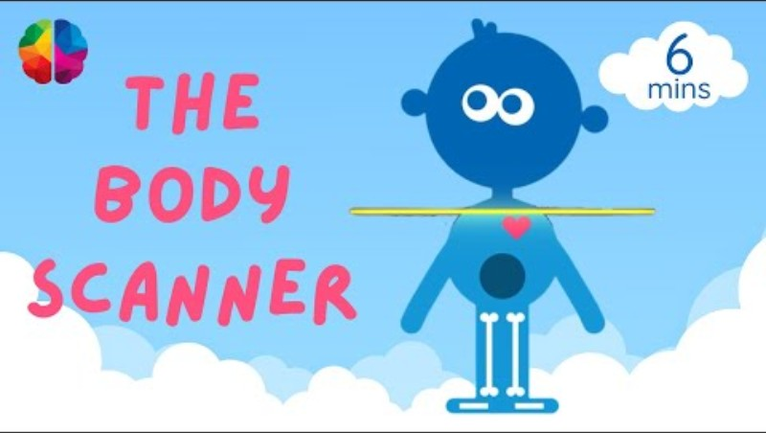
How to support autistic young people with alexithymia and interception difficulties
Source: The Mindfulness Teacher on YouTube

Slide 19


Slide 20
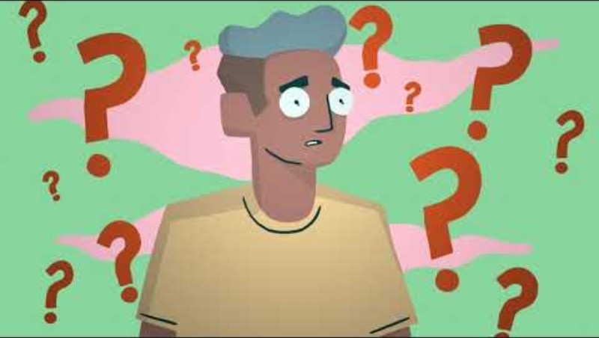
What is self-harm?
Source:
West Sussex County Council on YouTube

Slide 21
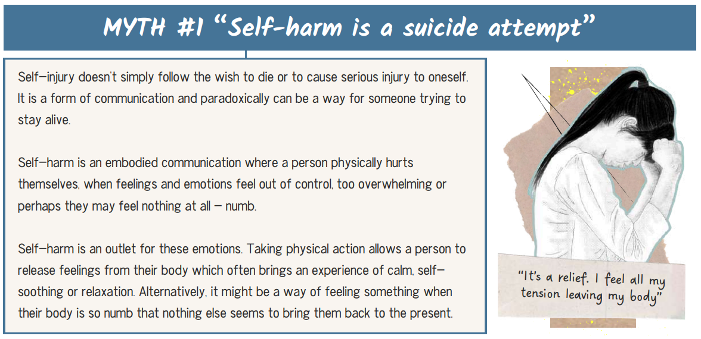
Self harm myths and facts
Source: Beacon House

Slide 22
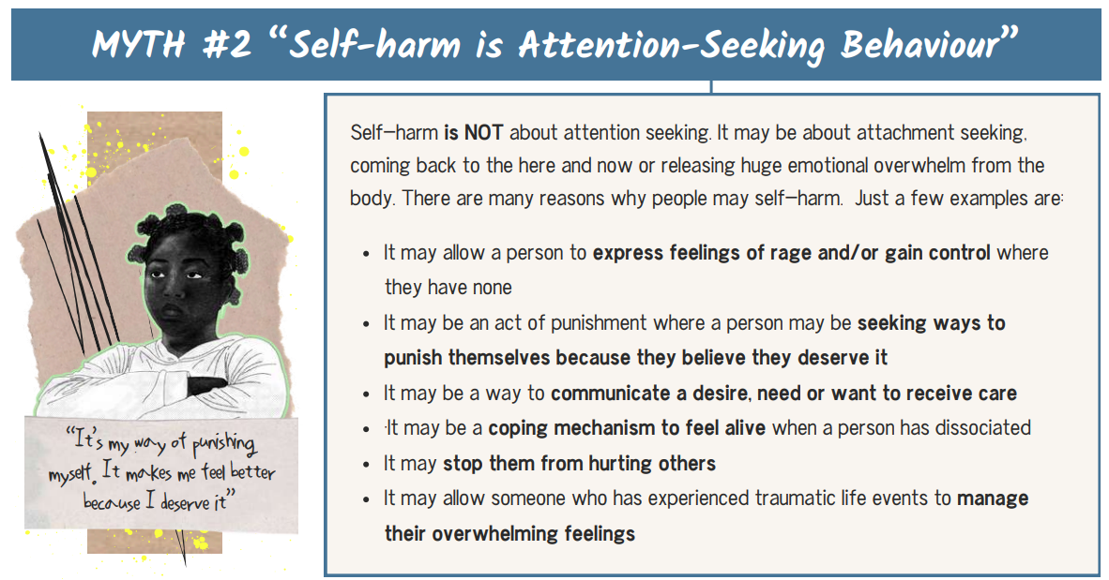
Self harm myths and facts
Source: Beacon House

Slide 23
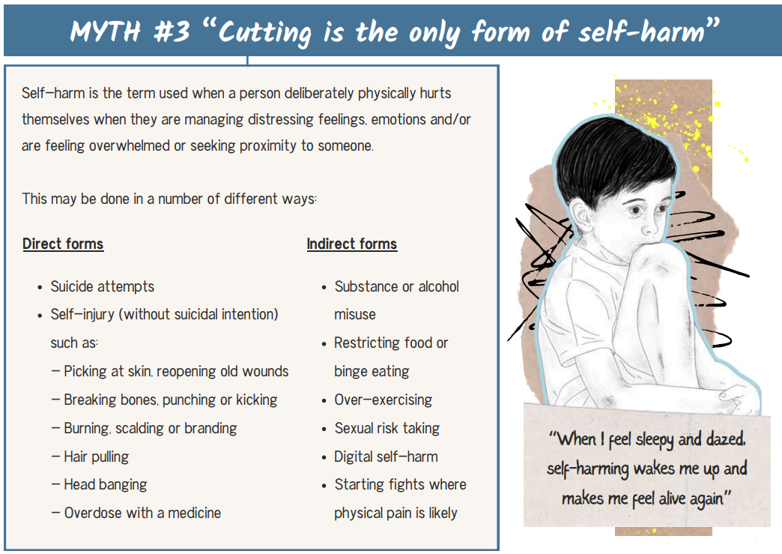
Self harm myths and facts
Source: Beacon House

Slide 24
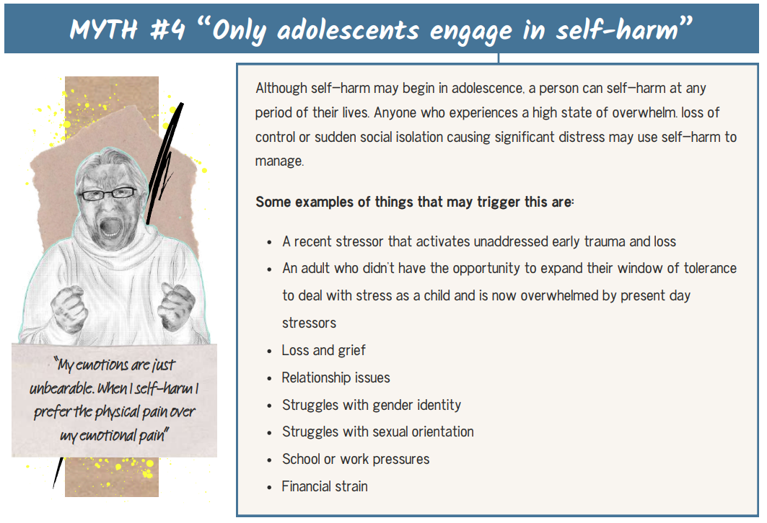
Self harm myths and facts
Source: Beacon House

Slide 25
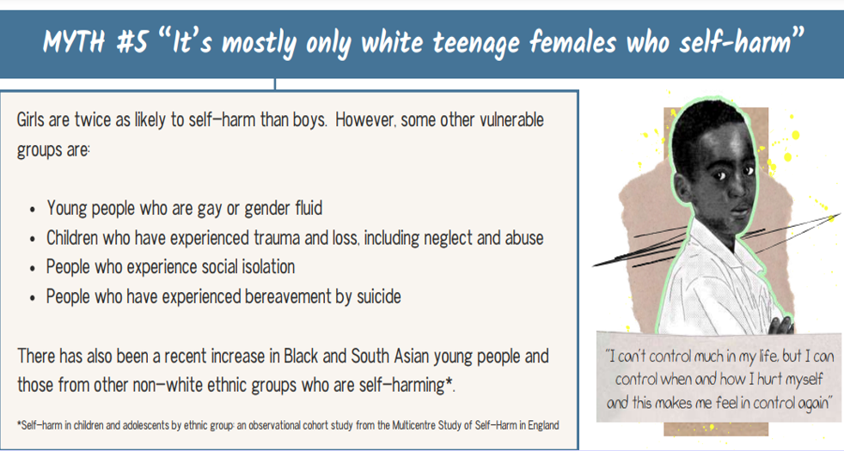
Self harm myths and facts
Source: Beacon House

Slide 26
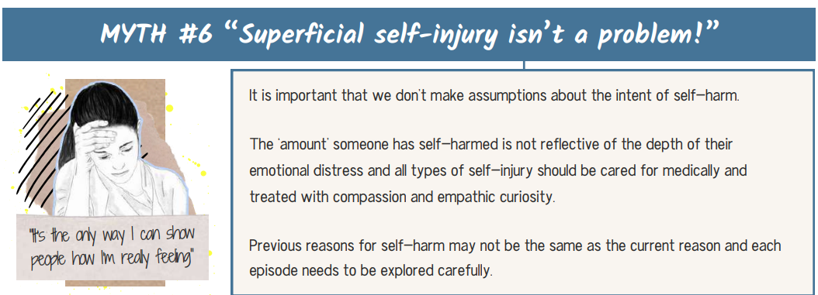
Self harm myths and facts
Source: Beacon House

Slide 27
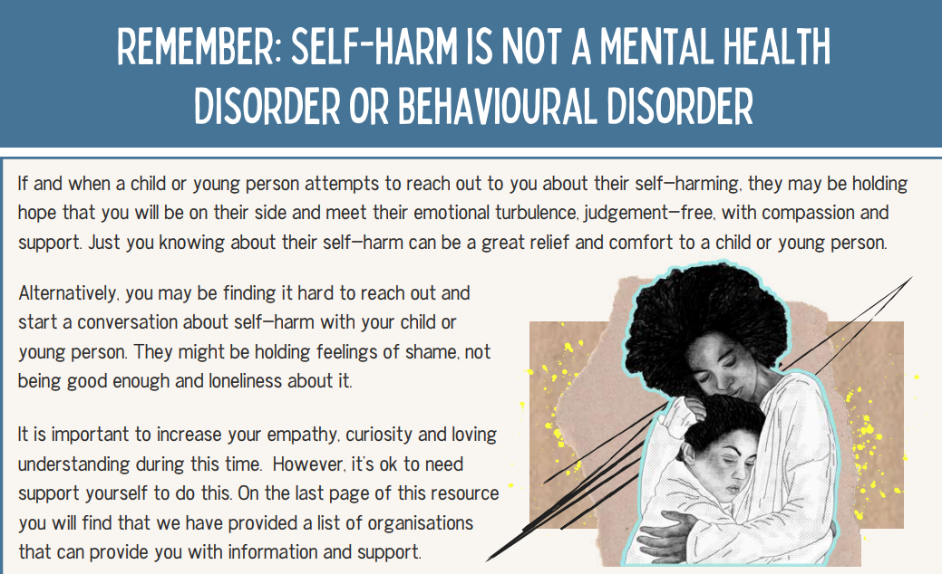
Self harm myths and facts
Source: Beacon House

Slide 28
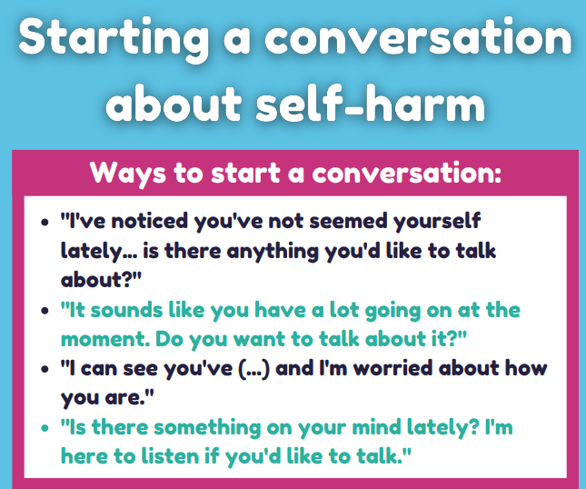

Slide 29
Helpful responses to a disclosure
“You are not in any trouble it's helpful that you have disclosed this to me.”
“It sounds like you are having a difficult time his OK to struggle and I'm here to listen.”
“You are not alone there's lots of support available and I'm here to help.”
“I understand this is difficult to cope right now we can explore other strategies that will help you cope whilst keeping you safe.”

Slide 30
Safer ways to cope
If a young person is self harming as a way of coping with difficult feelings or situations, it may not be helpful for them to stop immediately. Instead, we can help them develop alternative coping strategies that still provide relief but reduce the risk of health complications (e.g. infections from untreated injuries.)
If angry: Hit cushions or a pillow, squeeze a rubber ball really hard, play loud music, tear something up into lots of pieces, like a newspaper or a book you no longer need, clench then relax all your muscles, write or draw on paper what has made you angry, then scrunch it up
If sad or fearful: Wrap yourself in something cosy, such as a jumper or blanket, spend time with an animal, or cuddle a soft toy, go for a walk to somewhere that you find soothing, and take someone with you if this would help, journal your feelings - writing them down, or record a video or audio clip, let yourself cry or sleep, listen to soothing music, call or message someone that you care about, call a helpline, such as Samaritans, or Self injury Support or use a peer support service like Side by Side, breathing exercises.
If feeling disconnected: Wash your face with cold water, draw or put a plaster on the area of your body that you want to harm, massage the area where you want to harm yourself

Slide 31
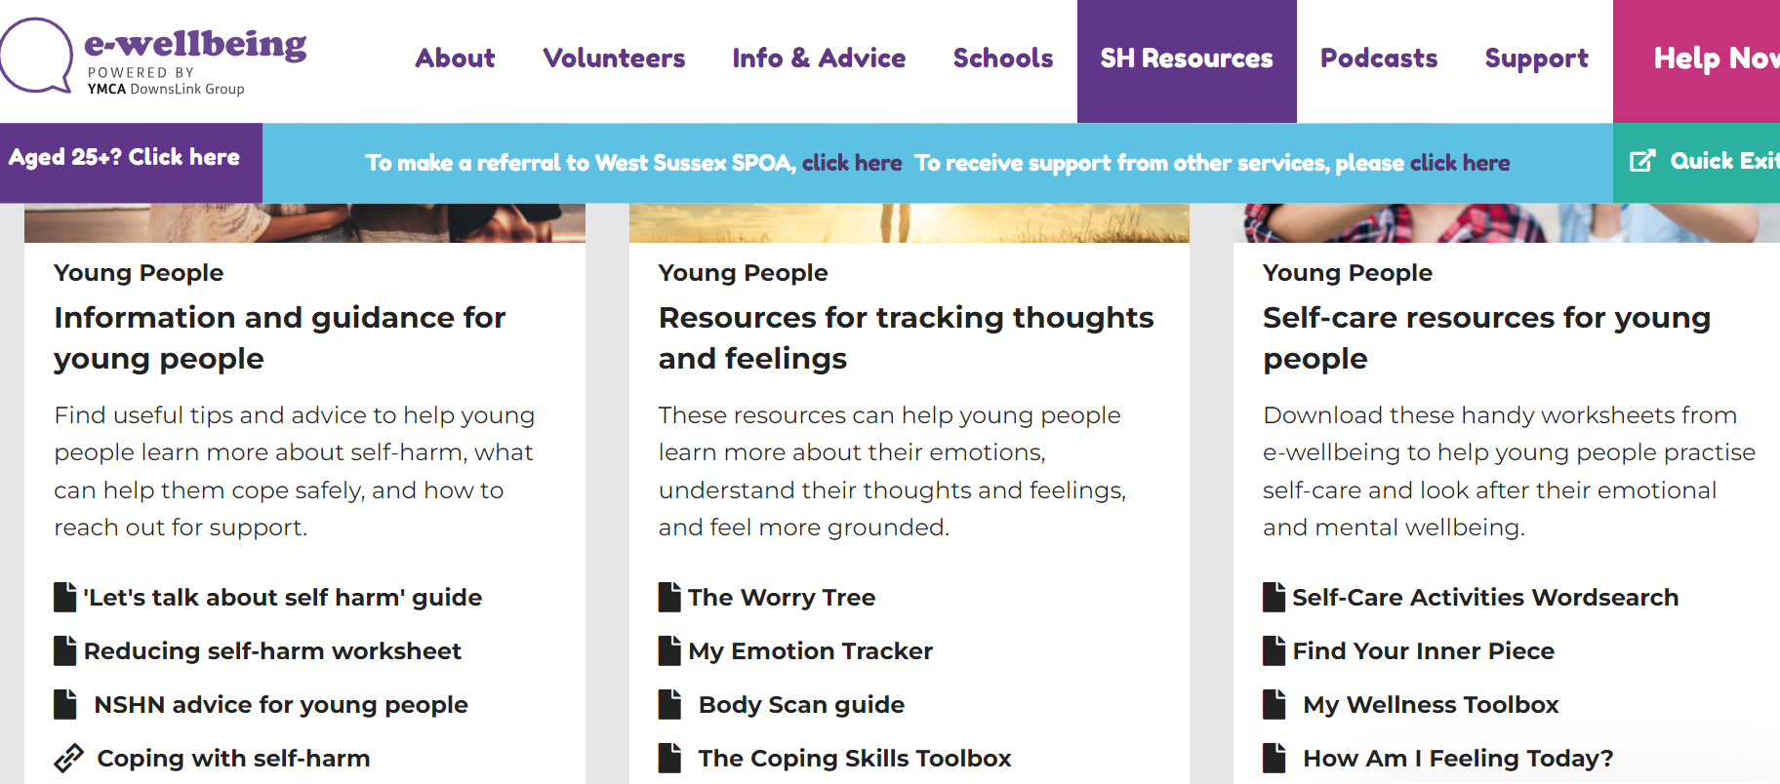
Please spend 10 minutes reviewing the resources to see if there are any which could be helpful for you…..

Slide 32
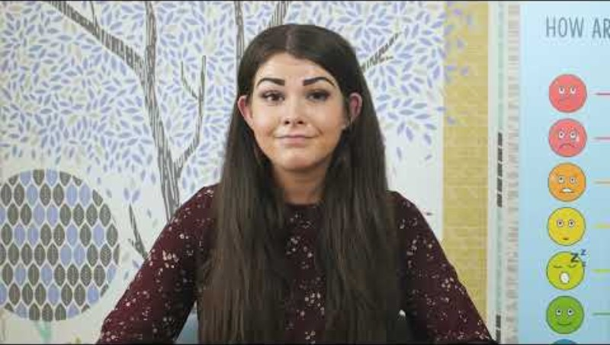
Self-care for neurodivergent people- self-soothe boxes
Have you used these successfully with anyone you are supporting? Any tips?

Slide 33
Self-care for neurodivergent people- rest
Autism and ADHD can have a big impact on a person’s ability to rest. Their nervous systems can be more reactive and therefore can release more stress hormones into their bodies making it harder to rest.
Neurodivergent ‘rest’ can look different from neurotypical rest and may need a different approach which considers how their bodies and brains work.

Slide 34
Self-care for neurodivergent people- rest
Rest and neurodiversity
Pottering- tidying/organising, gardening, light housework.
Being in nature away from things which add to sensory overload.
Sensory comfort- clothing, candles, weighted blankets, hammocks, electric blankets
Watching safe tv programmes/films, listening to safe music
Engage in special interests

Slide 35
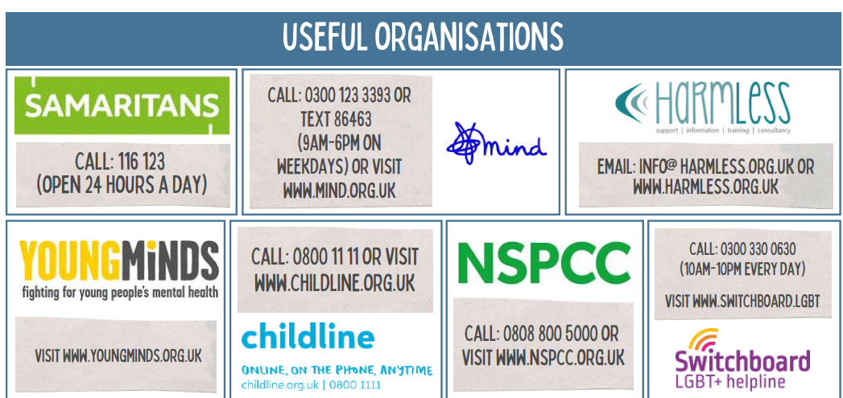
Support options…

Slide 36
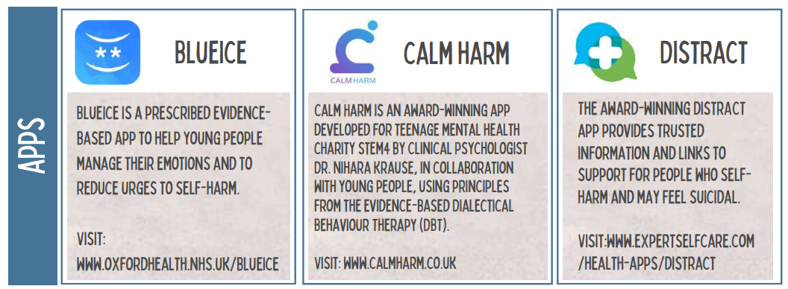
Support options…

Slide 37
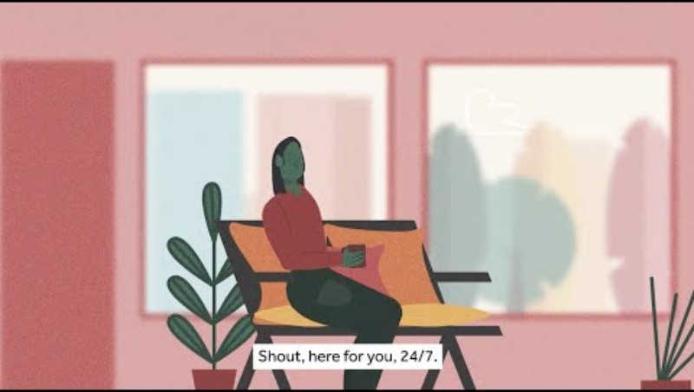
Support options…SHOUT 85258

Slide 38

Support options…

Slide 39
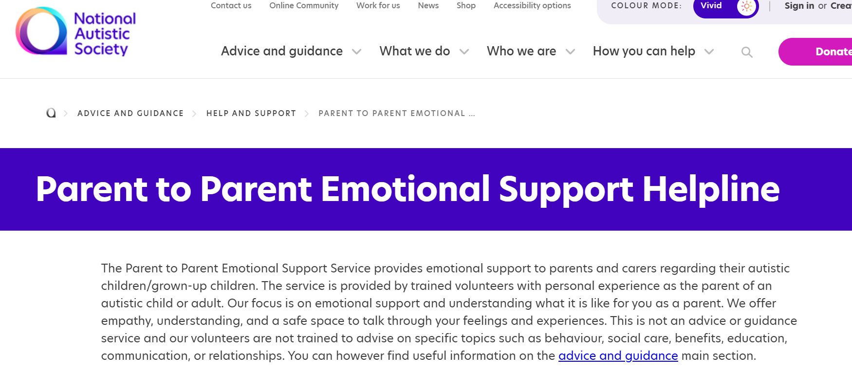
Support options…

Slide 40

This Photo by Unknown Author is licensed under CC BY-NC

