Slide 1


Slide 2
What is mental health?
Our mental health is on a spectrum, and can range from good to poor.
Good mental health can help you to think positively, feel confident and act calmly.
Poor mental health, is when everyday things become difficult to cope with.
Notes:
Mental health can affect your body. If you’re feeling anxious you may feel nauseous (sick), dizzy or have a headache.

Slide 3
Put your hand up if:
You have ever broken a bone
You have ever cut your finger
You have ever had a headache
You have ever had a toothache
You have ever had a tummy ache
Notes:
EXERCISE: Let’s start by thinking about our physical health – things to do with our body.
I will say a statement, and if this is something you have felt before, you put your hand up :
Put your hands up…
EXERCISE: Ask, what can make us feel better? – can anyone think of and share some ways we look after our physical health? For example, when we have a headache or broken bone.

Slide 4
Now I want you to think if:
You have felt happy in the last week?
You have felt sad in the last week?
You have ever felt excited?
You have ever felt scared?
You have ever felt worried?
Notes:
EXERCISE: Now let’s start thinking about our mental health.
I’m not going to ask you to put your hand up for this exercise, as not everyone will feel comfortable sharing their feelings and mental health experiences. So I am just going to read out the statement and give you the opportunity to think about it.
You have felt happy in the last week?
You have felt sad in the last week?
You have ever felt excited? Explainer: Excitement could be what you felt when you were going on holiday or when you were little and waiting to meet Father Christmas.
You have ever felt scared? Explainer: This might be what you feel when you’re somewhere heigh up, you see a spider in the room, or you’re going to a new place. Different people are scared of different things.
You have ever felt worried? Explainer: This could be what you feel before your first day of school, or before a competition like a football match.
All of these feelings make up our mental health. It’s important to remember that we all have mental health the same way we all have physical health. Sometimes our mental health is good, other times, its bad. Like physical health, there are ways we can look after our mental health which we will talk about later in today’s session.

Slide 5
All of these feelings make up our mental health.
It’s important to remember that we all have mental health the same way we all have physical health.
Sometimes our mental health is good, other times, its bad.
Like physical health, there are ways we can look after our mental health.

Slide 6
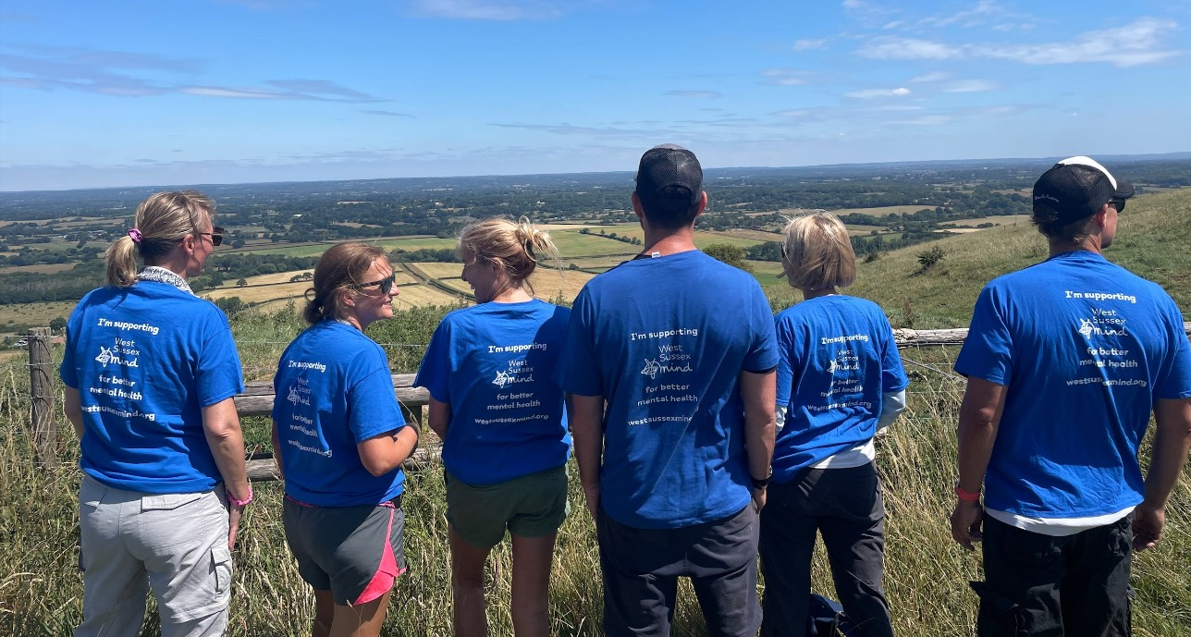
Who are West Sussex Mind?
Independent charity – affiliated to national Mind
The Gateway, Worthing
Maltravers Drive, Littlehampton

Slide 7

The current situation
We’re in the midst of a mental health crisis with an enormous scale of unmet need. There is...
Growing levels of demand for support
A cost-of-living crisis
Insufficient public funding
Difficulty accessing healthcare
High levels of stigma

Slide 8
Our Vision
We will not give up until everyone experiencing a mental health problem gets both support and respect.

Slide 9
In 2024-25 we.....
Supported 7,766 people
9,547 calls answered by our Help Point for advice, information, and support
Young People:
Supported 1,428 children and young people (up to 25)
Delivered 3,869 support sessions
261 Parents and carers supported

Slide 10

Support for children and young people through West Sussex Mind
Be OK Service for 16 – 18 in the community
CYP (Children and Young People Service)
in some GP practices for 8 - 18 year olds
Notes:
Notes for further info on services:
CYP:
Worried about mental health
Feeling anxious or depressed
Self-harming or having thoughts about it
Having family problems or struggling with friendships at college or work because of mental health
Diagnosed with a mental health problem and looking for support
Getting help from services but this is coming to an end as they reach 18
Be OK Service for 16 – 18 in the community, and for 8 - 18 year olds in many GP practices
Creating a personalised support plan
Usually up to 6 one-to-one support sessions, including informal 'walk and talk' appointments.
Help getting other support in the community
For Be OK – peer support, social groups and activities

Slide 11
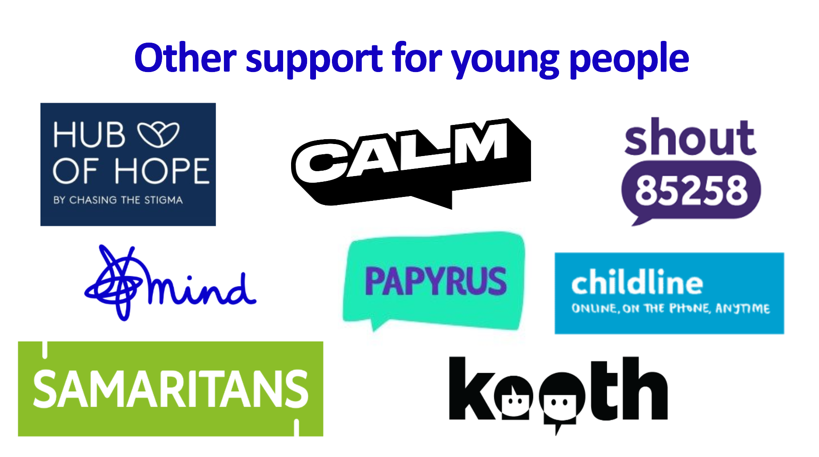
Notes:
Notes for where to get support:
Samaritans - Contact Us | Samaritans
Mind - How to seek help for a mental health problem
Papyrus Hopeline - HopeLine 24/7 | Papyrus
Calm - I'm struggling | Campaign Against Living Miserably
Shout - Get help - free, 24/7, confidential mental health text support service | Shout 85258
Childline - Contacting Childline | Childline
Kooth - Home - Kooth
Hub of Hope - Mental Health Support Network provided by Chasing the Stigma | Hub of hope

Slide 12

Text SHOUT to 85258 to contact the Shout textline
Call HOPELINE247 on 0300 102 2470 or the
NHS on 111 and select option 2
Contact Childline by using 1-2-1 chat or calling 0800 1111
If you feel like you may try to attempt suicide, or you or someone else is seriously hurt:
Call 999 and ask for an ambulance
Tell an adult you trust and ask them to call 999 for help
Emergency Support Lines:
Notes:
First point of contact for:
Mental Health Advice
Information
Signposting
Self-help tools and support
Access to West Sussex Mind services

Slide 13
Service User Story
Click the link below:
https://www.youtube.com/watch?v=zbJyCVsBTS4&time_continue=4&source_ve_path=MjM4NTE&embeds_referring_euri=https%3A%2F%2Fukc-powerpoint.officeapps.live.com%2F
Notes:
Young People's Service | West Sussex Mind
See our website and youtube channel for more videos

Slide 14
3 in 5 young people have either experienced a mental health problem themselves, or are close to someone who has.

Slide 15
How mental health impacts young people
We can all feel sad, worried, angry or fed up at times – like nerves before an exam or feeling down when a friend moves away. But if these feelings last a long time, it might be a sign that you need more help. For example, if the way you feel:
Impacts you most days
Stops you from doing the things you enjoy
Makes you feel like you can't cope anymore.
Reach out for support.

Slide 16
Whatever you are experiencing, it’s important to know that you are not alone and you deserve support.

Slide 17
Self Help Videos on our Website/YouTube
Click the link below:
How to support someone who is self-harming: a guide for young people
Notes:
In case video doesn't work, see our website/youtube channel
How to support someone who is self-harming: a guide for young people

Slide 18
Helping my mental health
Talking being open with people I trust about how I’m feeling.
Exercising looking after my body, playing sport, eating healthy.
Calming trying meditation, good sleep habits like turning phone off early.
Learning a new skill, a great way to gain confidence.
Relating spending time with the people I care about.
Contributing helping others or contributing to causes I believe in.
Creating expressing myself creatively e.g. music, art, drama, writing.
Congratulating being kind to myself or listing the qualities I value in myself.

Slide 19
Wellbeing first aid kit
Using the suggestions on the previous slide, create your own mental
health first aid kit. Include the types of things that you could do when
you’re finding things hard.
Here are some examples:
  Chatting to my best friend about how I’m feeling
  Drawing while listening to my favourite music
  Having a long bath
Notes:
EXERCISE: Your wellbeing first aid kit will be unique to you. You can take inspiration from the previous slide, and include the things that you know work for you when you’re not feeling yourself.
Share your wellbeing first aid kit with the person sitting next to you. Discuss why you have selected those activities and how they make you feel.

Slide 20
Mental Health problems don't define who you are. They are something you experience. You walk in the rain, and you feel the rain, but, importantly, you are not the rain
- Matt Haig

Slide 21
Notes:
Notes for where to get support:
Samaritans - Contact Us | Samaritans
Mind - How to seek help for a mental health problem
Papyrus Hopeline - HopeLine 24/7 | Papyrus
Calm - I'm struggling | Campaign Against Living Miserably
Shout - Get help - free, 24/7, confidential mental health text support service | Shout 85258
Childline - Contacting Childline | Childline
Kooth - Home - Kooth
Hub of Hope - Mental Health Support Network provided by Chasing the Stigma | Hub of hope

